Slide 1
Lab 2: Information Retrieval
Ying shen and Hao deng
School of software engineering
tongji university

Slide 2
Five-stage search framework
A five-stage search framework help to coordinate design practices and satisfy the needs of all users
Formulation 构想
Initiation of action 发起动作
Review of results 评审结果
Refinement 细化
Use 使用：编辑、传播结果
Five-stages can be repeated until users’ needs are met
If users are unsatisfied with the results, they should be able to have additional options and change their queries easily
Notes:
Formulation: Expressing the search
Initiation of action: Launching the search
Review of results: Reading messages and outcome
Refinement: Formulating the next step
Use: Compiling or disseminating insight

Slide 3
Formulation
Use simple and advance search 简单 高级
Limit the search using structured fields such as year, media, or location 结构化字段-限制
Recognize phrases to allow entry of names, such as “George Washington” 短语
Permit variants to allow relaxation of search constraints (e.g. phonetic variations)
Control the size of the initial result set
Use scoping of source carefully
Provide suggestions, hints, and common sources

Slide 4
Initiation of action
Explicit actions are initiated by buttons with consistent labels (such as “Search”) 显式：按钮
Implicit actions are initiated by changes to a parameter and update results immediately
Guide users to successful or past queries with auto-complete

Slide 5
Review of results
Keep search terms and constrains visible
Provide an overview of results (e.g. total number) 数量、
Categorize results using metadata (by attribute value, topics, etc.)
Provide descriptive previews of each result item 预览：文字、图片、视频
Highlight search terms in results 突出关键词
Allow examination of selected items
Provide visualizations when appropriate (e.g. maps or timelines)
Allow adjustment of the size of the result set and which fields are displayed
Allow change of sequencing (alphabetical, chronological, relevance ranked, etc.)

Slide 6
Refinement
Guide users in progressive refinement with meaningful messages
Make changing of search parameters convenient
Provide related searches 相关搜索（推荐）
Provide suggestions for error correction (without forcing correction) 纠错建议

Slide 7
Use
Imbed actions in results when possible ：跟踪（Google快讯）
Allow queries, setting, and results to be saved, annotated, and sent to other applications
Explore collecting explicit feedback (ratings, reviews, like, etc.)

Slide 8

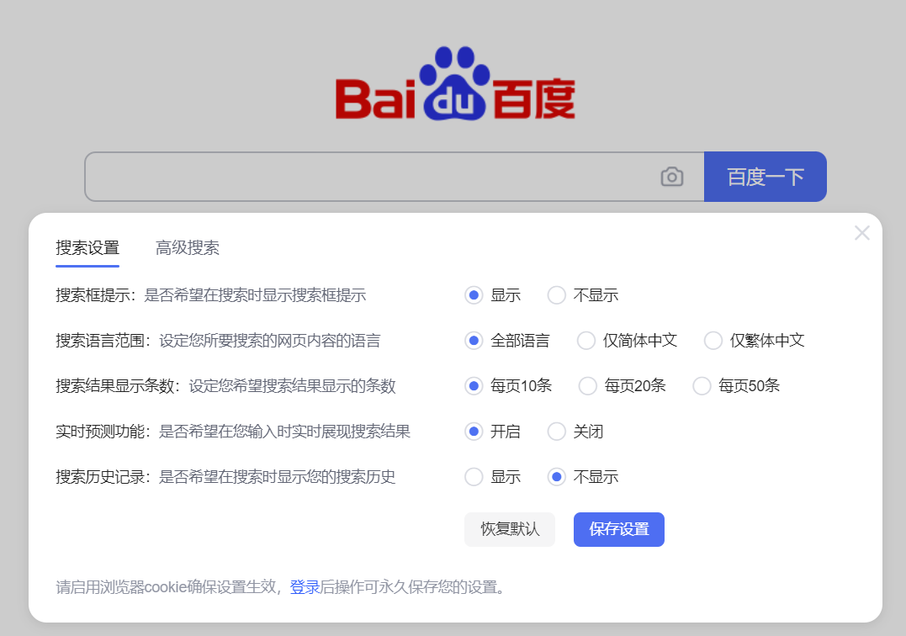
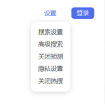
Examples – Web search
Formulation and Initiation
Choose scope
Input keywords
Initiate the action

Slide 9
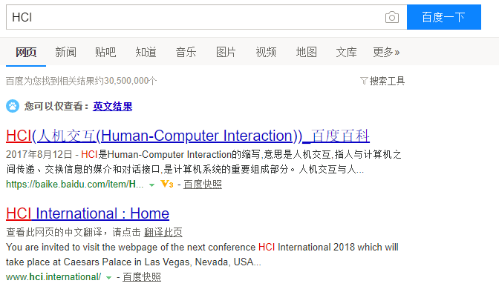
Examples – Web search
Review of results
Search term
Overview
Suggestions
Highlight search terms
descriptive previews
Source

Slide 10
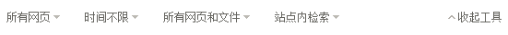
Examples – Web search
Refinement
Change search parameters

Slide 11
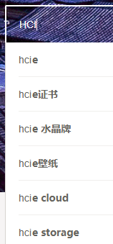

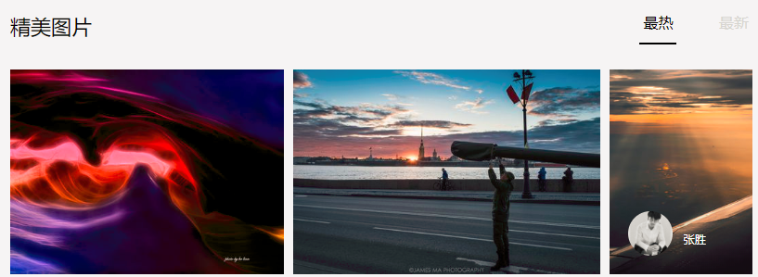
Examples – Image search
Formulation and Initiation
Auto-completion
Initiate the action
Input keywords
Suggestions
Search using pictures

Slide 12
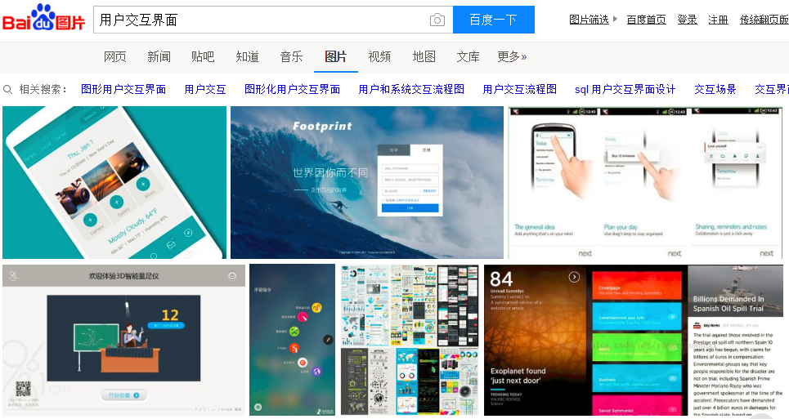
Examples – Image search
Review of results, Refinement
Search term
Suggestions

Slide 13

Examples – Image search
Change search parameters
Refinement

Slide 14
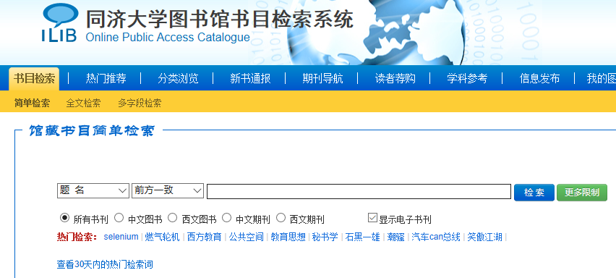
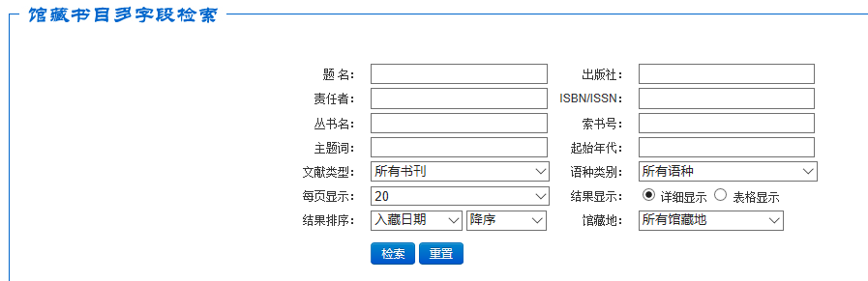
Examples – Document search
Formulation and Initiation
Simple search
Advanced search

Slide 15
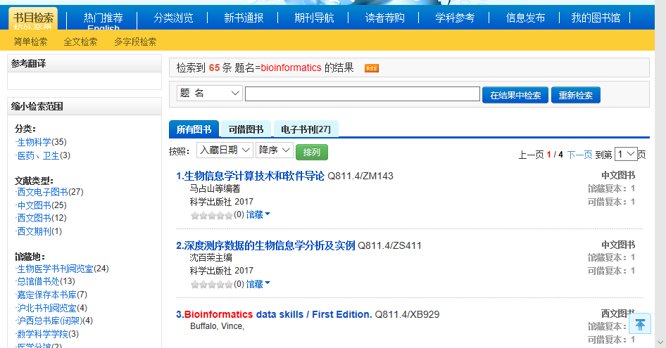
Examples – Document search
Review of results
Overview
Categorize results using metadata
Change of sequencing
Highlight search terms

Slide 16
Examples – Document search
Refinement
Progressive refinement

Slide 17
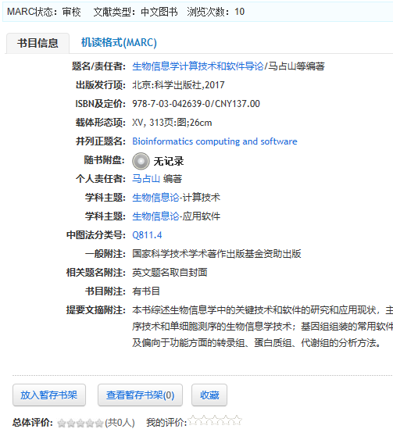
Examples – Document search
Use
Possible actions
Feedback

Slide 18
Install packages
Python (64bit)
Flask
PyQt5 (v5.11.3)
numpy
tensorflow
Flask-HTTPAuth
scipy
imageio
matplotlib
sklearn
...

Slide 19
How to run
run server/image_vectorizer.py
Run image vectorizer which passes each data through an inception-v3 model and collects the bottleneck layer vectors and stores in disc. Edit dataset paths accordingly inside the image_vectorizer.py
This will generate two files namely, image_list.pickle and saved_features.txt. Keep them inside lib folder where search.py script is available.
run server/rest-server.py
Start the server by running rest-server.py. This project uses flask based REST implementation for UI
Once the server starts up, access the url (for example) 0.0.0.1:5000 to get the UI. Now upload any file and see 9 similar images. You can change the value of K from 9 to any values, but don’t forget to update the html file accordingly for displaying.
Notes:
source codes are from: https://github.com/vinayakkailas/Deeplearning_Image_Similarity

Slide 20
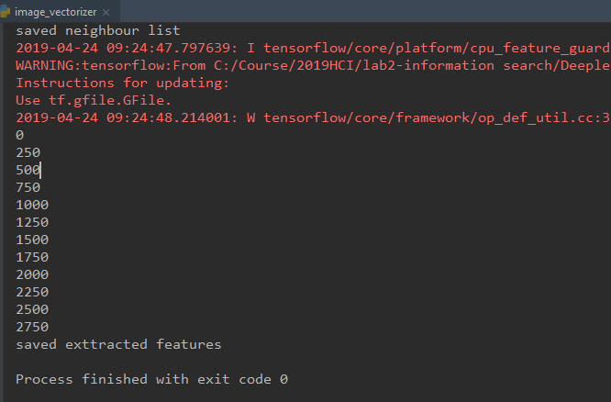
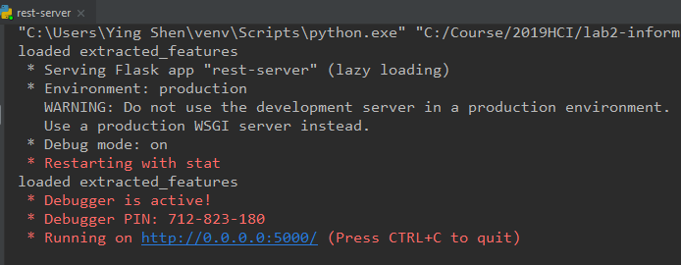
How to run

Slide 21
Assignment
Design and implement an image search system (interface) according to the Five-Stage Framework
The searching interface has the following features:
It contains an input box to upload an image (Formulation);
Users can preview the query image in the searching window (Formulation);
It has a search button (Initiation);
Provide an overview of the results (e.g. the total number of results) (Review);
Allow changing search parameters (e.g. select certain category/tag) when reviewing results (Refinement);
Users can take some actions, e.g. add selected images to a favorite list (Use);
Other functions you would like to add in.

Slide 22
Report
The report should contains the following contents (in English):
Describe the requirements of an image search task;
Show your designs for five stages and give a brief description for features that you implement.
Submit your work (code and report)
Prepare a readme file to illustrate how to run your program
Compress the codes and the report into a zip file: ID_name_lab2.zip
Email address: timcan@foxmail.com
5月20日前，迟交1天扣1分

